Slide 1
CT Lung Cancer Prediction using CNN
Project Guide:
Mrs.Sheebha AP-CSE
Team Members:
M.Saravana Kumar(950421104044)
J.Arockia Jerin(950421104010)

Slide 2
Abstract
Lung cancer is a major global health concern, and early detection is crucial for improving survival rates
CT scans is time-consuming and prone to human error. Machine Learning (ML) and Deep Learning, especially Convolutional Neural Networks (CNNs), provide an automated and accurate approach to lung cancer detection.
The LIDC-IDRI dataset is commonly used to train deep learning models. Preprocessing techniques like image normalization, lung segmentation,

Slide 3
Problem Statement
Delayed and Inaccurate Diagnosis
Misclassification of Cancer
Scalability and Accessibility Issues
Time-consuming, and prone to human errors, leading to delays in early diagnosis and treatment
Some cancerous nodules may be missed, resulting in incorrect classification , affecting treatment decisions
The growing number of lung cancer cases demands an automated, need for an AI-based system that helps doctors detect cancer quickly and accurately

Slide 4
Proposed System
01
02
03
Preprocessing
Enhances CT images using normalization, segmentation, and nodule detection
We propose an AI-based system that uses Convolutional Neural Networks (CNNs) to detect lung cancer from CT scans automatically
This system helps in early detection, reduces errors, and improves lung cancer diagnosis.
Feature Extraction
CNN models like ResNet, VGG, and 3D CNNs identify key lung patterns.
Fast & Scalable Diagnosis
You can describe the topic of the section here

Slide 5
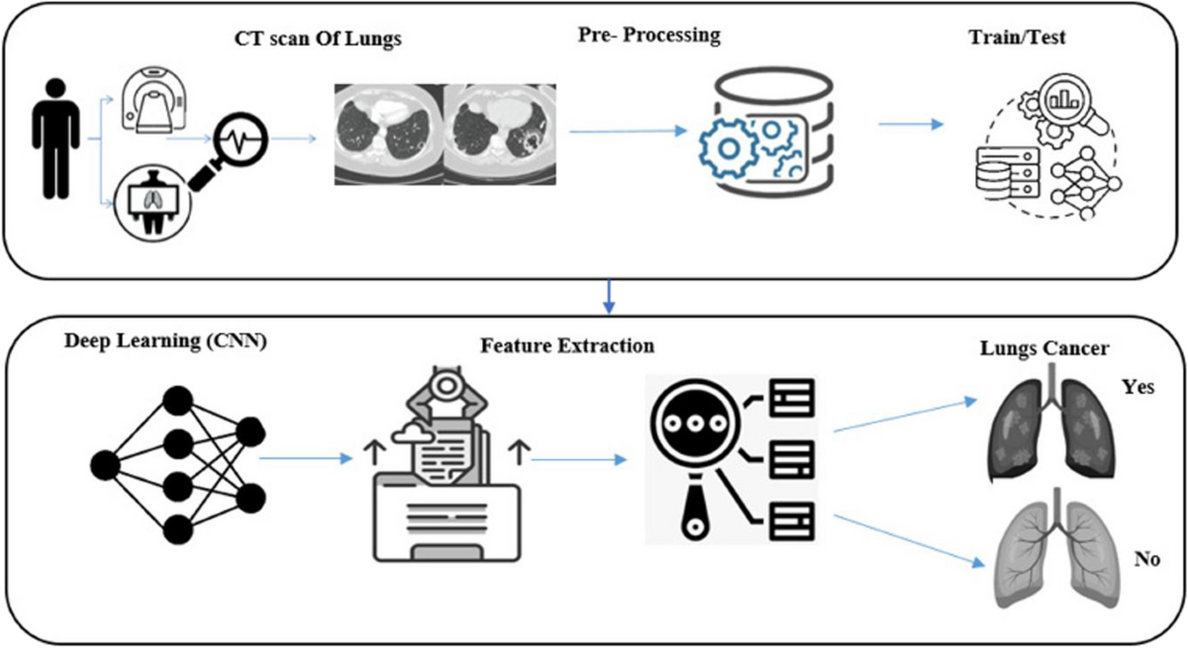
Architecture Diagram

Slide 6
Modules
Data Acquisition
Data set(kaggle)
Data Preprocess
Enhances image quality
Train &Test
Uses CNN to extract important features
Classification
Uses a trained CNN model
Prediction
Displays results to the user

Slide 7
Data Acquisition (kaggle dataset)
A Kaggle dataset is training and testing deep learning models.
datasets contain labeled lung nodule images, helping Convolutional Neural Networks (CNNs) detect and classify lung cancer as benign or malignant.
Data set
CT scan images from sources like LIDC-IDRI and Kaggle datasets.
Using three types of Datasets:
Lung Adenocarcinoma (Lung ACA)
Lung normal dataset(Lung N)
Lung Squamous Cell Carcinoma(Lung SCC)

Slide 8
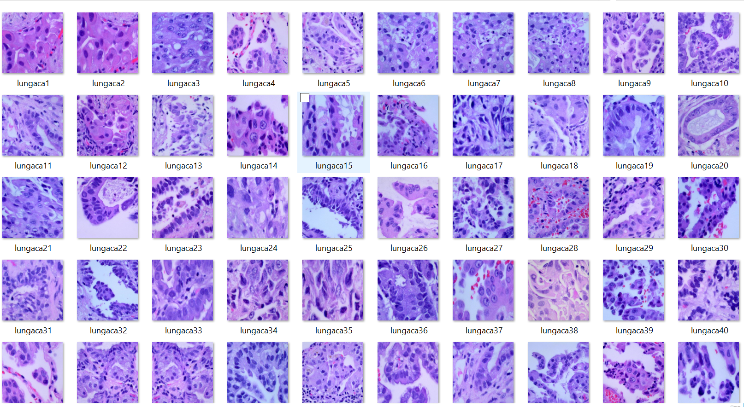
Adenocarcinoma (Lung ACA)
Lung Squamous Cell Carcinoma (SCC) is a type of lung cancer that starts in the cells lining the airways. It is mostly caused by smoking and usually grows in the center of the lungs,
Lung SCC img set:

Slide 9
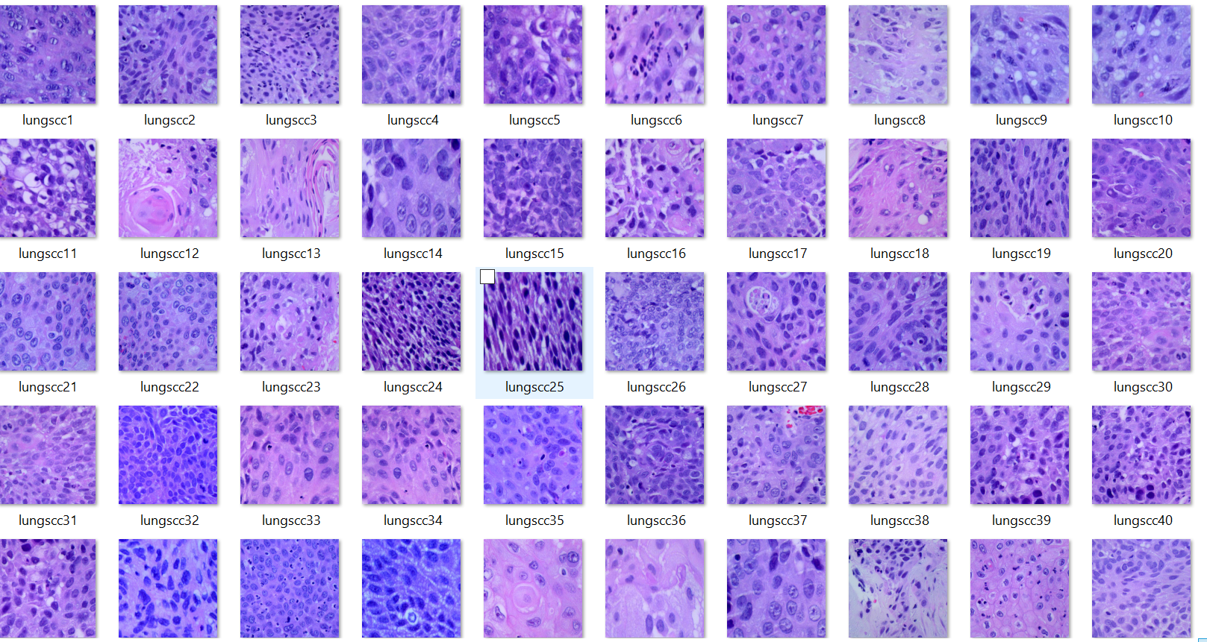
Squamous Cell Carcinoma(Lung SCC)
Lung Adenocarcinoma (Lung ACA), which is a common type of non-small cell lung cancer (NSCLC). Adenocarcinoma is the most common form of lung cancer, especially among non-smokers
Lung ACA img set:

Slide 10
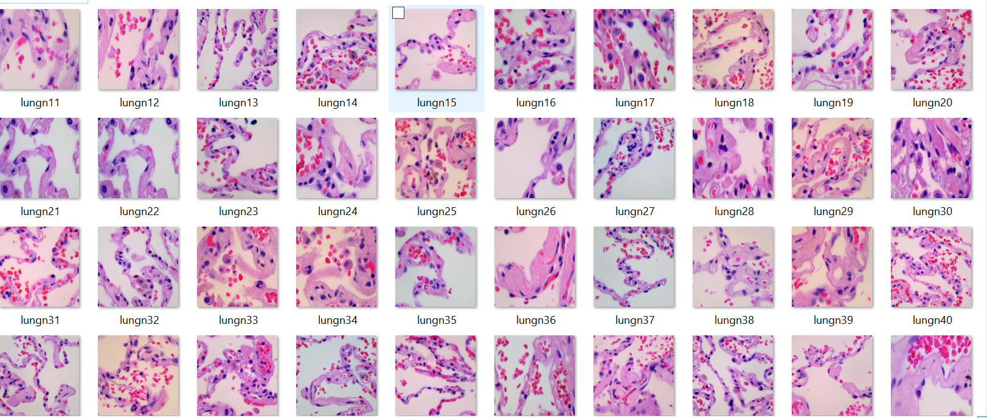
Lung normal dataset(Lung N)
Lung normal(Lung N), the lungs are functioning properly, with no signs of disease, infection,no cancer
Lung N img set:

Slide 11
Data preprocessing
Load and Normalize Images:
Convert DICOM/NIfTI images to PNG/JPEG format
.
Resize images to 224x224 (or suitable input size).
Data preprocess
Noise Removal
Apply Gaussian Blur or Median Filtering to remove noise.
improves accuracy by removing noise and standardizing input data

Slide 12
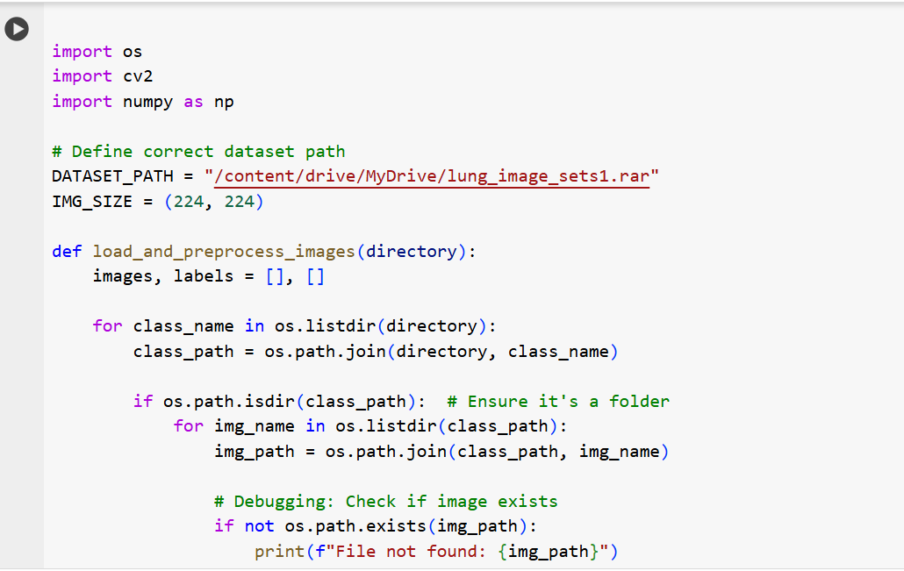

Data preprocessing (I/O)
Paste the image path correctly.

Slide 13
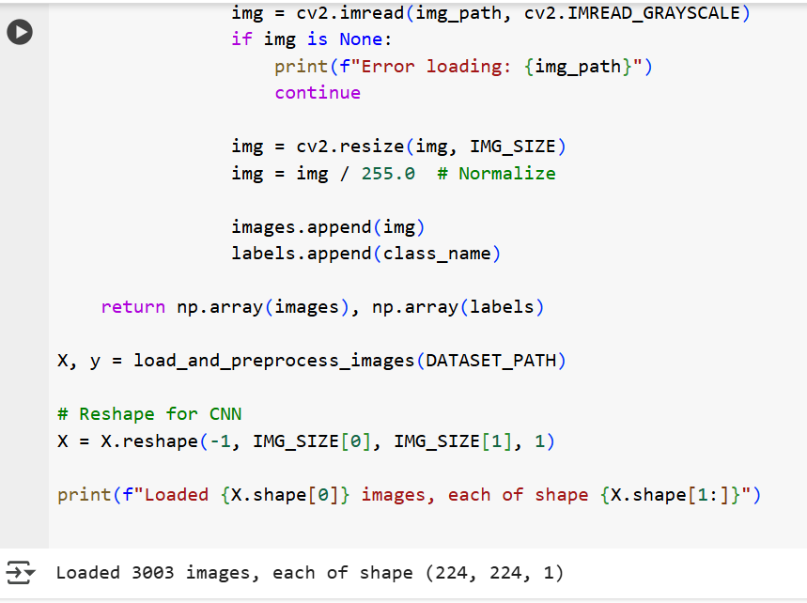
Data preprocessing (I/O)
Output

Slide 14
Train &Test
Training Set
This is the data the model learns from.
You feed it examples (CT images labeled as cancer or non-cancer), and it tries to learn patterns.
Testing Set
This is a separate portion of data that the model has never seen before.
After training, you use the test set to see how well the model performs on new data.
It helps you evaluate how well the model would work in real-life situations.

Slide 15
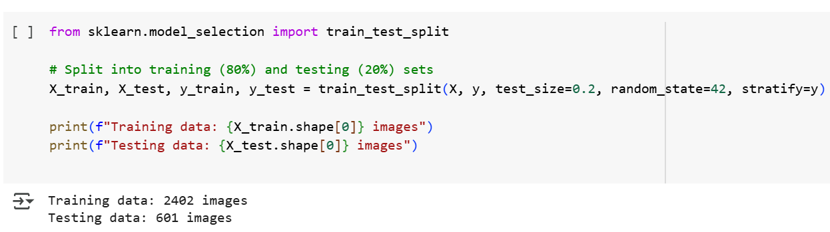
Training & Testing (I/0)
output

Slide 16
Feature Extraction
learns and extracts important features that help classify normal and cancerous tissues.
Low-Level Features (First Layers)
Edges & Corners → Detects lung nodule boundaries.
Textures & Patterns → Identifies tissue structures
Mid-Level Features (Deeper Layers)
Shapes & Contours → Recognizes tumor shapes.
Density & Intensity → Differentiates normal and abnormal regions.
High-Level Features (Final Layers)
Tumor Localization → Highlights cancerous areas.
Benign vs. Malignant Classification → Determines cancer severity.

Slide 17
Image Classification
The goal is to classify a given CT scan into benign (non-cancerous) or malignant (cancerous) categories.
Input CT Scan Image
Feature Extraction Using CNN
The system takes preprocessed lung CT scan images
Convolutional Layers detect important features like edges, shapes, and textures.
Classification Using Fully Connected Layers
Final Prediction
Extracted features are flattened and passed through dense layers.
image being cancerous or non-cancerous. High accuracy is achieved through deep learning training

Slide 18
Future Scope
1. AI and Machine Learning in Early Detection
Deep Learning for Imaging: AI-powered tools can analyze CT scans and X-rays to detect lung cancer at earlier stages with higher accuracy.
Automated Screening: AI can help in screening large populations efficiently, reducing the burden on radiologists.
2. Liquid Biopsy & Biomarkers
Non-Invasive Testing: Blood tests (liquid biopsies) will become more effective at detecting lung cancer biomarkers, reducing reliance on biopsies.
3. Nanotechnology-Based Diagnosis
Nano-Sensors for Early Detection: Breath analysis and nanotechnology-driven biosensors can detect cancer-related molecules in exhaled air.
4. Integration of Multi-Omics Data
Genomics, Proteomics, and Metabolomics: Combining multiple biological data sources will enhance early detection accuracy and treatment effectiveness.
5. Telemedicine & Remote Screening
AI-Powered Mobile Applications: Remote lung health monitoring apps will help in early risk assessment.

Slide 19
Hardware Recommendations
Processor (CPU):
Intel Core i5 / i7 / i9 or AMD Ryzen 7 / 9
RAM:
Minimum 16GB, recommended 32GB+
Storage (ROM/SSD):
1TB SSD
Operating System (OS):
Windows 10/11, Linux (Ubuntu), or macOS
Display:
Full HD or 4K monitor

Slide 20
Literature Survey
S.No | Paper title | Author& Year | Methodology used
1 | Lung Nodule Detection and Classification Using Deep Convolutional Neural Networks | Y. Xie . (2018) | A 2D Faster R-CNN framework was adapted with two Region Proposal Networks (RPNs) and a deconvolutional layer to detect potential nodules in each patch.
2 | Hybrid Deep Learning and Machine Learning Approach for Lung Nodule Detection and Classification | Gugulothu and Balaji (2023) | Chaotic Bird Swarm Optimization (CBSO) algorithm to segment lung nodules from CT images.
3 | A Reference Dataset for Lung Nodule Detection and Diagnosis | S. G. Armato . (2021) | CT images are converted to Hounsfield Units (HU) for intensity standardization.

Slide 21
Thanks!
Any quqries..?

